Slide 1
AMAZON SES AND SQS
Introduction to SES and SQS
Case Studies of SES and SQS
Pros and Cons
Hands-On

Slide 2

AMAZON SQS
Amazon Simple Queue Service is a service which helps to align the messages
It helps to send , store and receive messages between the software components
Amazon SQS offers two queue types for different application requirements:
a. Standard Queue
b. FIFO Queue.

Slide 3
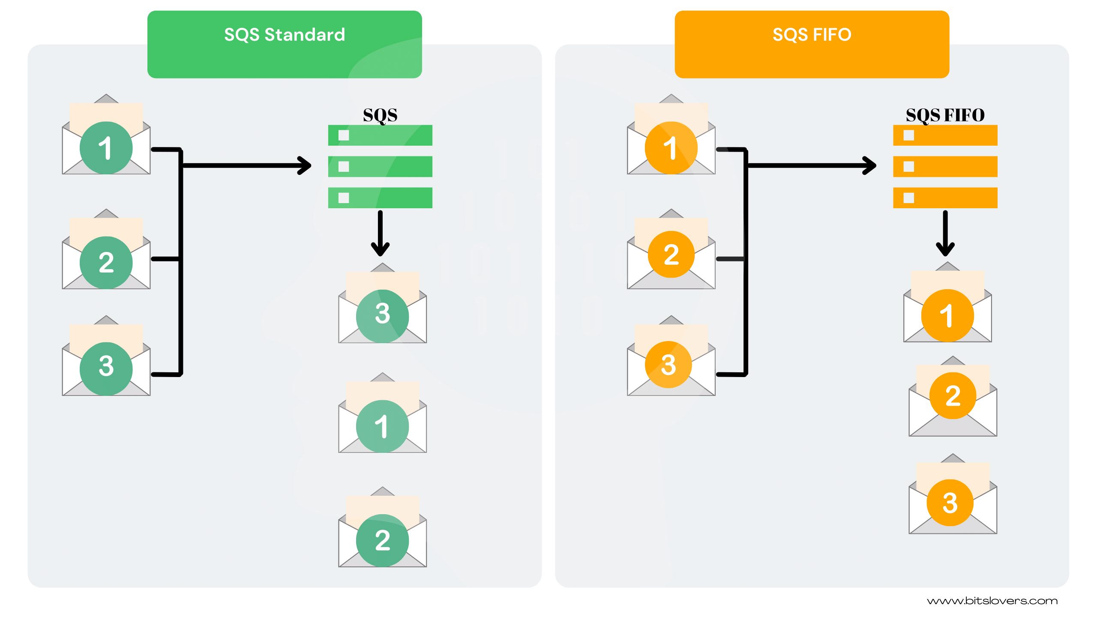

Slide 4
Case Studies
Environmental Monitoring Solutions
NASA
BMW
CaptialOne
Red Bus

Slide 5
Pros and Cons of SQS
PROS
Pay for what you use
Ease of setup
Options for Standard and FIFO Queues
Scalability
Automatic deduplication for FIFO queues
A separate queue for unprocessed messages
CONS
Inflight Messages
Message Size

Slide 6

AMAZON SES
Amazon Simple Email Service is a service which sends an email regarding marketing, transaction and notifications.
It can be directly integrated to the existing application with the help of SMTP Interface and Amazon SDK

Slide 7
Case Studies
Seetickets
Reddit
Netflix
Academia
Iterable

Slide 8
Pros and Cons of SES
PROS
High Deliverability
Cost Effective
Configurable
Reliable
CONS
Extremely Technical
Limited SMTP Functionality

Slide 9
Hands-0n
Commands to Create Queue
aws sqs create-queue --queue-name MyQueue
aws sqs create-queue --queue-name MystandardQueue --attributes file://create-queue.json
aws sqs create-queue --queue-name MyFifoQueue.fifo --attributes FifoQueue=true
Commands to Send message
aws sqs send-message --queue-url (copy the URL) --message-body "Welcome to Amazon SQS“
aws sqs send-message-batch --queue-url (copy the URL) --entries file://send-message-batch.json
Commands to Receive message
aws sqs receive-message --queue-url (copy the URL) --attribute-names All --message-attribute-names All --max-number-of-messages 10

